Slide 1
Business use case for Mall app
Notes:
Good evening. I would like to take the opportunity to talk about the Mall app as a digital solution to the business problem the clients have been facing.

Slide 2
Problem
Retail Space Property Owners suffer from loss of tenants and unable to collect rent
Shop Owners suffer from profitability loss because customers are moving to online shopping and E-commerce
Notes:
As it stands, retail space property owners suffer from a reduction of visits, and because of that the shop owners suffer from a profitability loss.
As a result, property owners suffer a loss of tenants due to the reduction of rent collected

Slide 3
Hypothesis
Profitability problems of shop owners and landlords in the retail space can be solved by increasing the revenue of shop owners collectively
Assumptions
Retail space shop owners and landlords are in the shopping mall/commercial hub space
Notes:
To tackle the problem statement, my initial working hypothesis is X. With this hypothesis in mind, I have made a few assumptions in order to reducing the problem boundary to be able to dive deeper into the problem. With that in mind I took the liberty to analyse the issue using a profitability framework

Slide 4
Profitability Model of Landlord
Profit
Revenue
Cost
Average Sales Price
Rent
Rent ↑ occupancy rate ↓
×
Volume
Occupancy rate
( Occupied outlets/ Available outlets )
Fixed Cost
- Maintenance Cost
Variable Cost
- Utilities
Demand
Profitability of shop owners
Notes:
Using a top-down approach, we first take a look at the retail space owner’s profitability model. Profit can be broken down into revenue and cost. Cost can be broken down into fixed cost and variable cost. Under the left side, revenue can be further broken down into average sales price, and volume.

Slide 5
Profitability Model of Shop Owner Collective
Profit
Revenue
Cost
Average Sales Price
×
Average Cost Price
Volume
×
Volume
Bundling
Promotions
Point Rewards System
Foot Traffic
Customer UX
Store Locator
Parking
Auxillary Services
Events
Dependent on businesses’ business model
Notes:
The shop owner’s profitability model can also be broken down into revenue and cost. In this case, the cost of the whole collective shop owners is really dependent on the individual business models themselves.
So we look into the revenue. In this case, the average sales price is the average amount spent by a customer when he/she walks into a commercial space. Volume in this case is well, number of customers. There are a few things that the shop owner collective can do to help bolster the average sales price.
On the other hand, volume can be improved through enhancing the customer UX and introducing events.

Slide 6
Profitability Model of Shop Owner Collective
Profit
Revenue
Cost
Average Sales Price
×
Average Cost Price
Volume
×
Volume
Bundling
Promotions
Point Rewards System
Foot Traffic
Customer UX
Store Locator
Parking
Auxillary Services
Events
Dependent on businesses’ business model
Notes:
Of course, the information of these features, as well as the features themselves, must be made ready available to the end user. So, the best way to deliver on these features is through the implementation of a

Slide 7
Mall App
Objective
To increase the revenue of shop owners as a whole, through augmenting the user experience visiting a mall
Responsibility
Provide various features to help ease the customer journey
Notes:
The objective of a map app is to help with the revenue issue of the shop owner collective, through enhancing the user journey.
So how does the mall app implement these features that we’ve discussed?

Slide 8
Features (Average Sales Price)
Bundling
E.g. Spend RM100 in Shop A to get 20% off ala carte items in Shop B
Show bundles and promotions (below) in app
Promotions
Discount coupons, new releases
Point Reward System
Point collection every time money is spent – Redemption of goods with points collected
User register themselves for point collection
Notes:
So first we look at features that help with the average sales price.
Bundling could be say, spend X amount at Shop A to get some bonus at shop B. We can lump that up with promotions, and call them value promotions in the app.
Point reward system would then be just like bonuslink. You spend X amount of money to get Y amount of points. The points you can use to redeem small value items like umbrellas, and cookingware.
The point reward system is there as an added feature to the customers, but the main purpose of this feature is for end-user education and performance tracking purposes, such that they will get used to using the app.

Slide 9
Features (Volume)
Store Locator
Digital interface in app
Parking Assist
QR code pillar car tracking / Parking space locator
Auxiliary Services
Wheelchair/Buggy ride/Child service information
Event
Event information
Notes:
On the other hand, volume enhancing features such as store locator and parking assist can manifest themselves as digital interface in the app. Parking assist can help the end user find empty parking spots as well as help track where did they park.
The app can also let the end user know the services you have in the mall, or any ongoing or upcoming events.

Slide 10
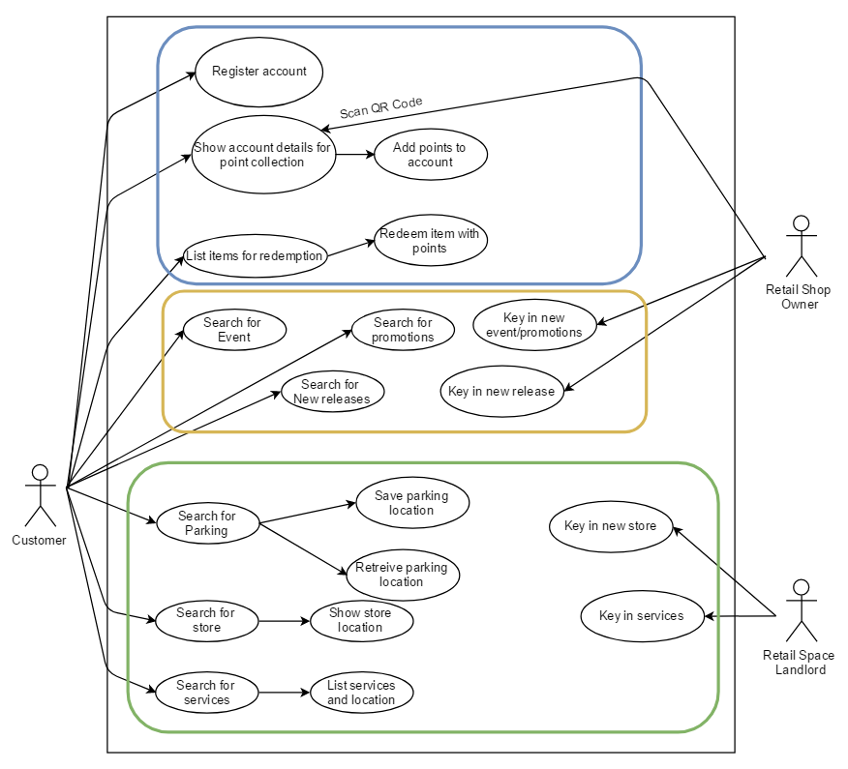
Use cases
Point reward system
Promotion and rewards
Location Service
Notes:
Okay so lets talk use cases. On the right is a use case diagram to demonstrate the use case between the customer, retail shop owner and retail space landlord. The use case diagram is huge. But can be broken down into three parts, the point reward system, promotion and rewards, and location services

Slide 11
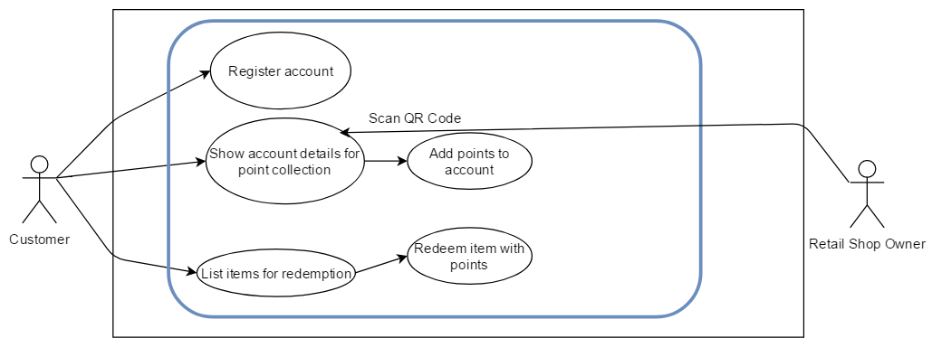
Use case - Point Reward System

Slide 12
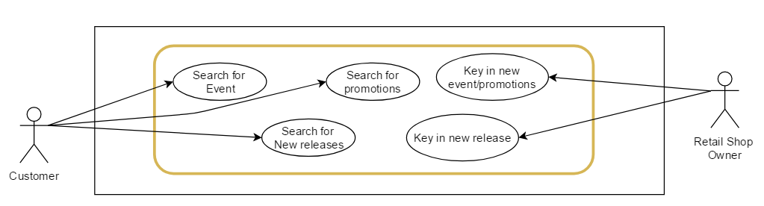
Use case – Events and Promotions

Slide 13
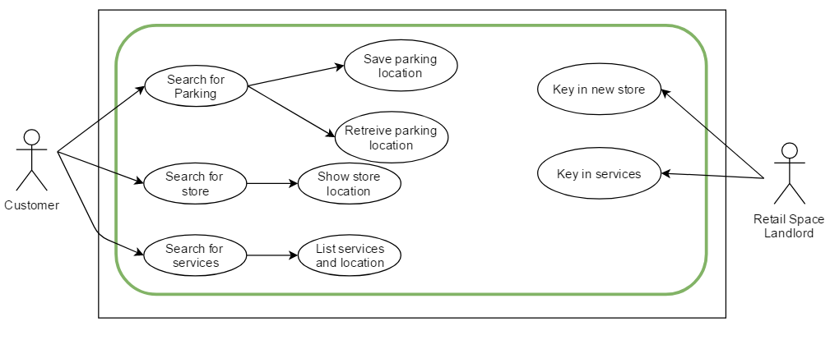
Use case – Location and Services

Slide 14
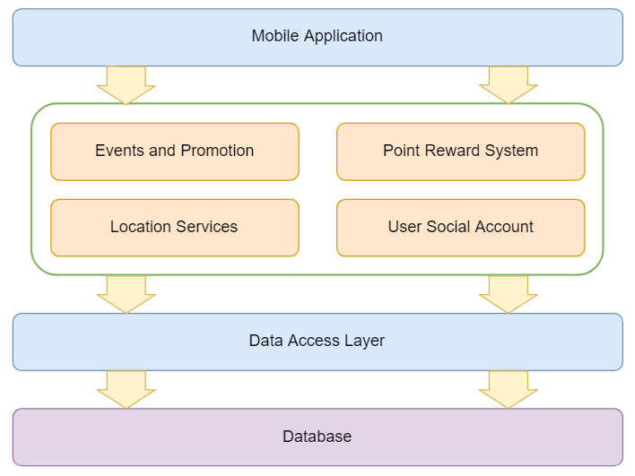
Software Architecture Diagram

Slide 15
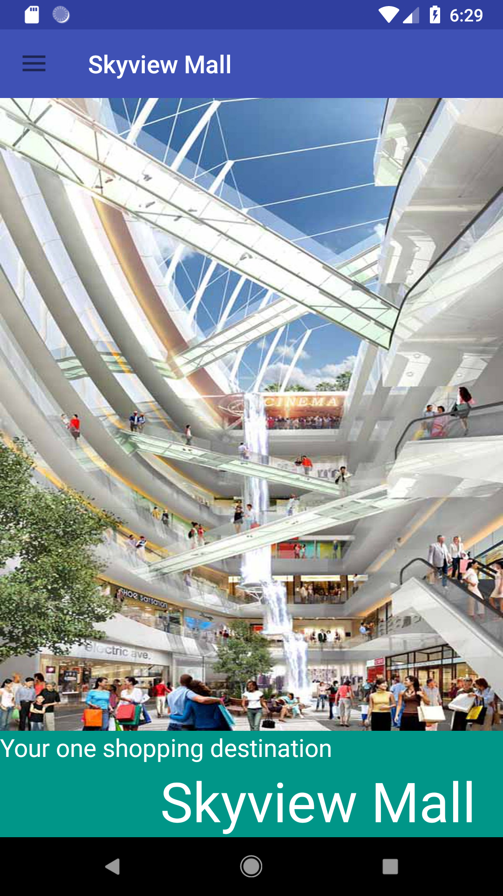
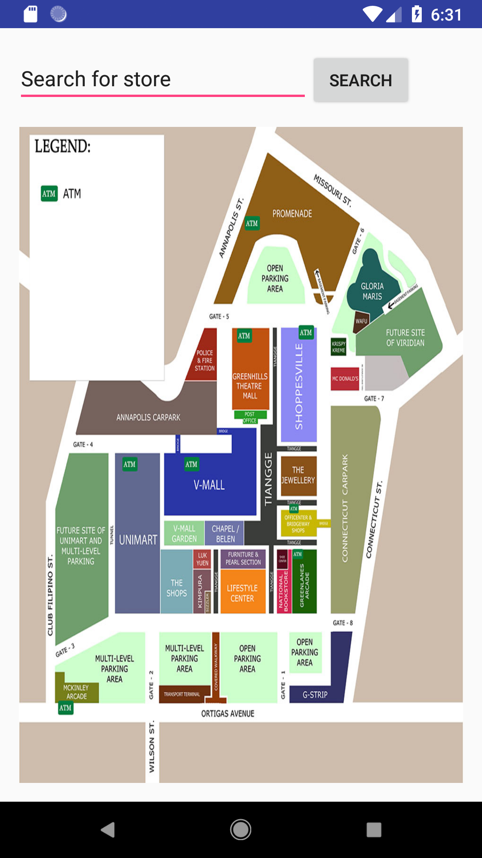
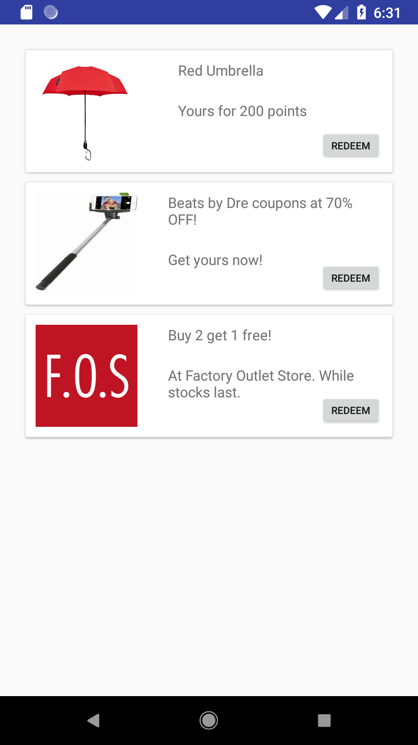
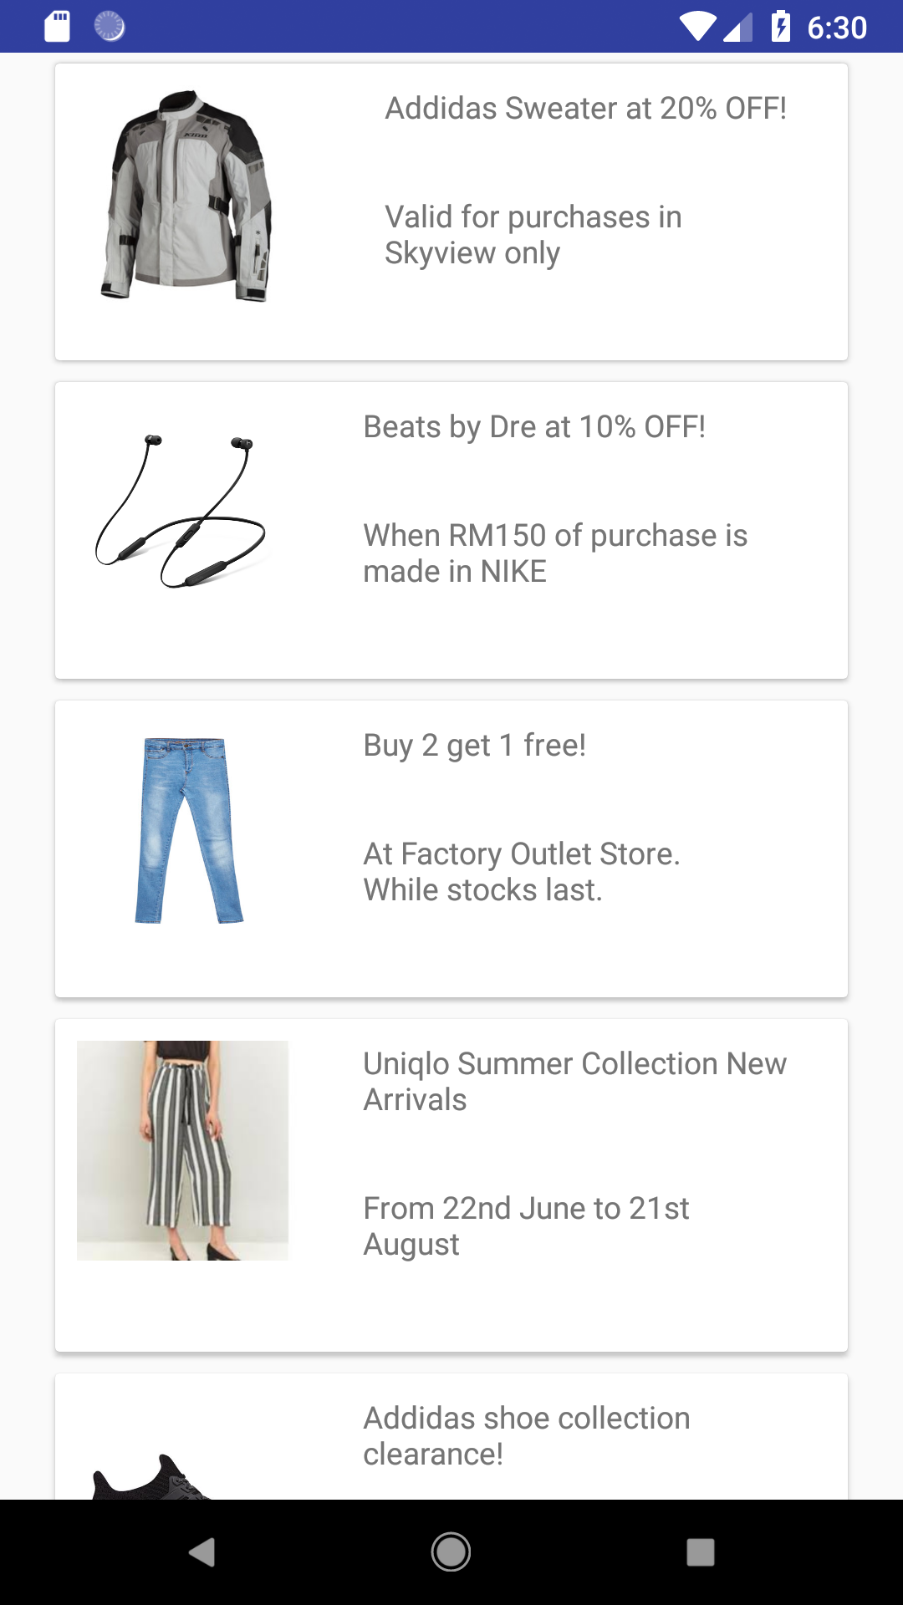
App Showcase

Slide 16
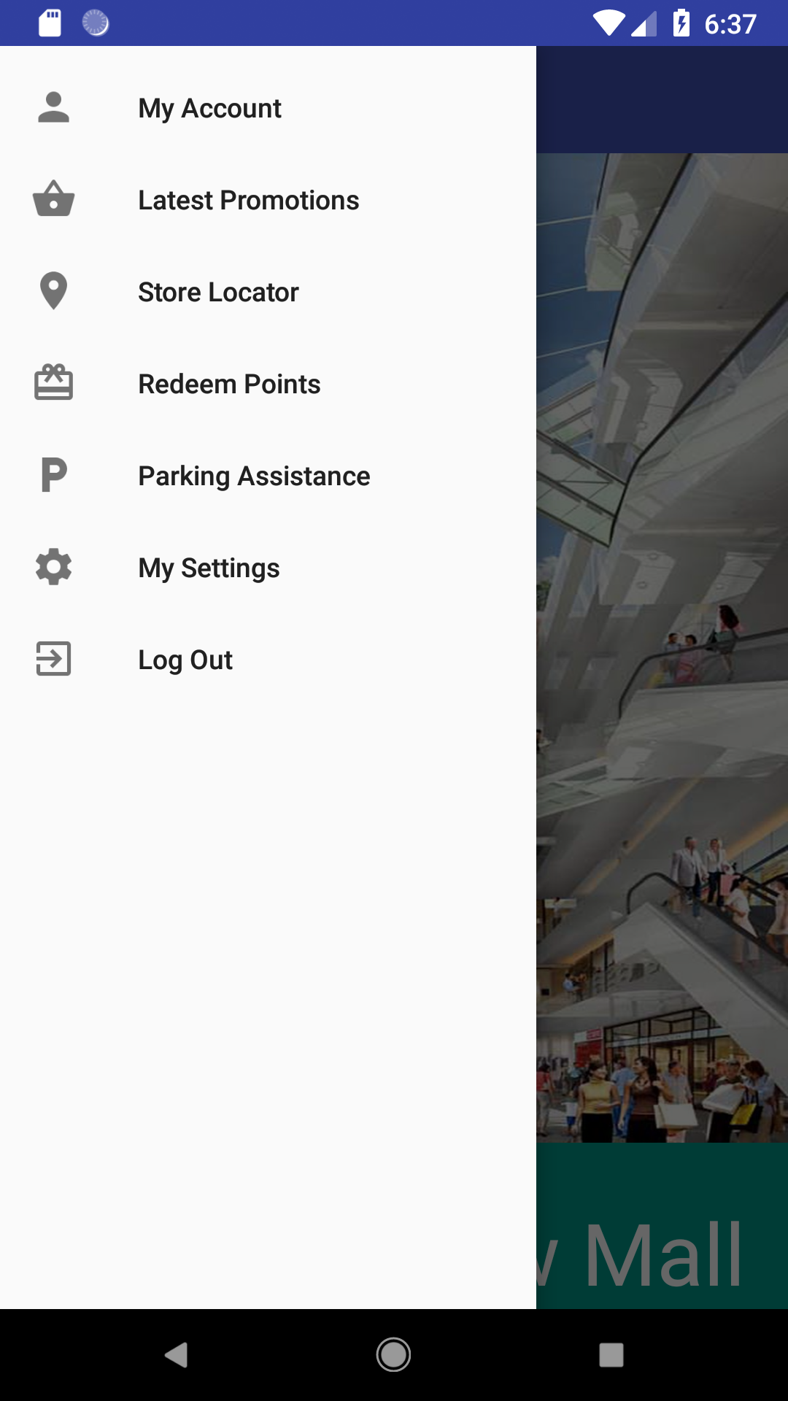
App Showcase
Main Menu

Slide 17
App Showcase
Main Menu

Slide 18
App Showcase
Rewards and Promotions

Slide 19
App Showcase
Location Services
Store Locator

Slide 20
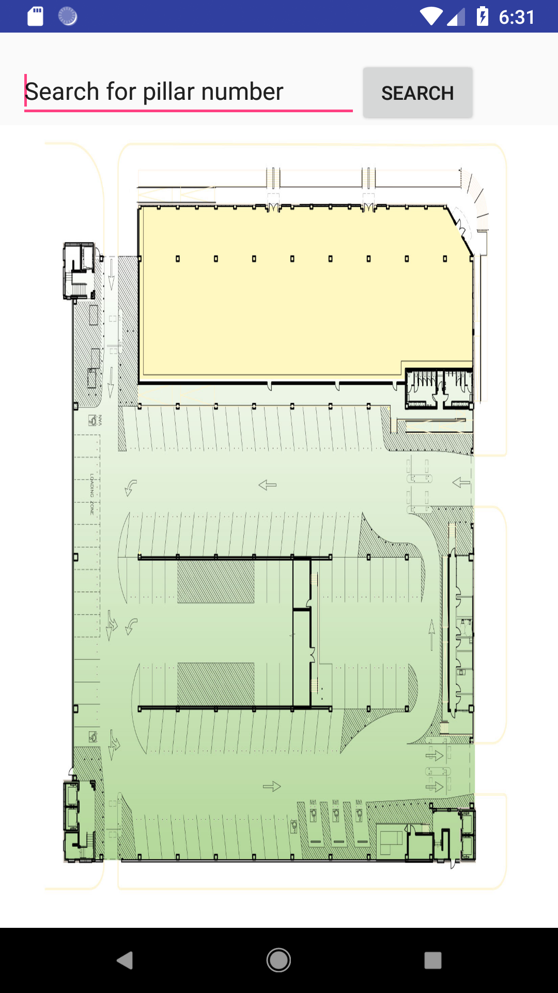
App Showcase
Location Services
Parking Locator

Slide 21
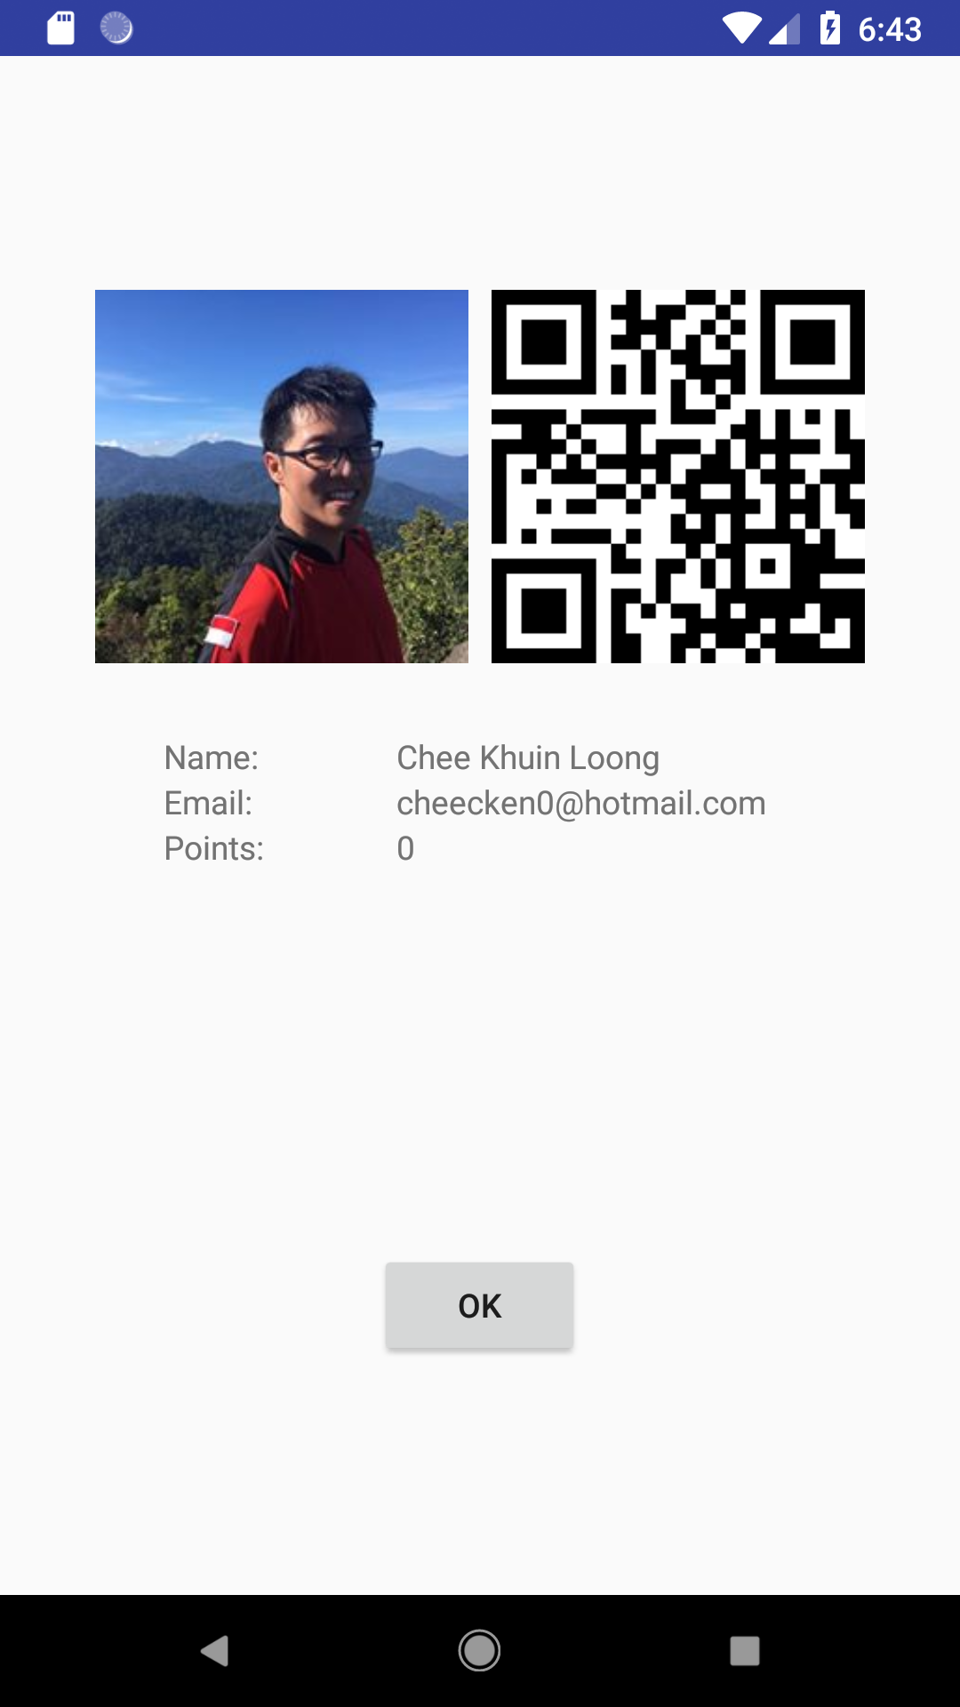
App Showcase
Point Reward System
User Page

Slide 22
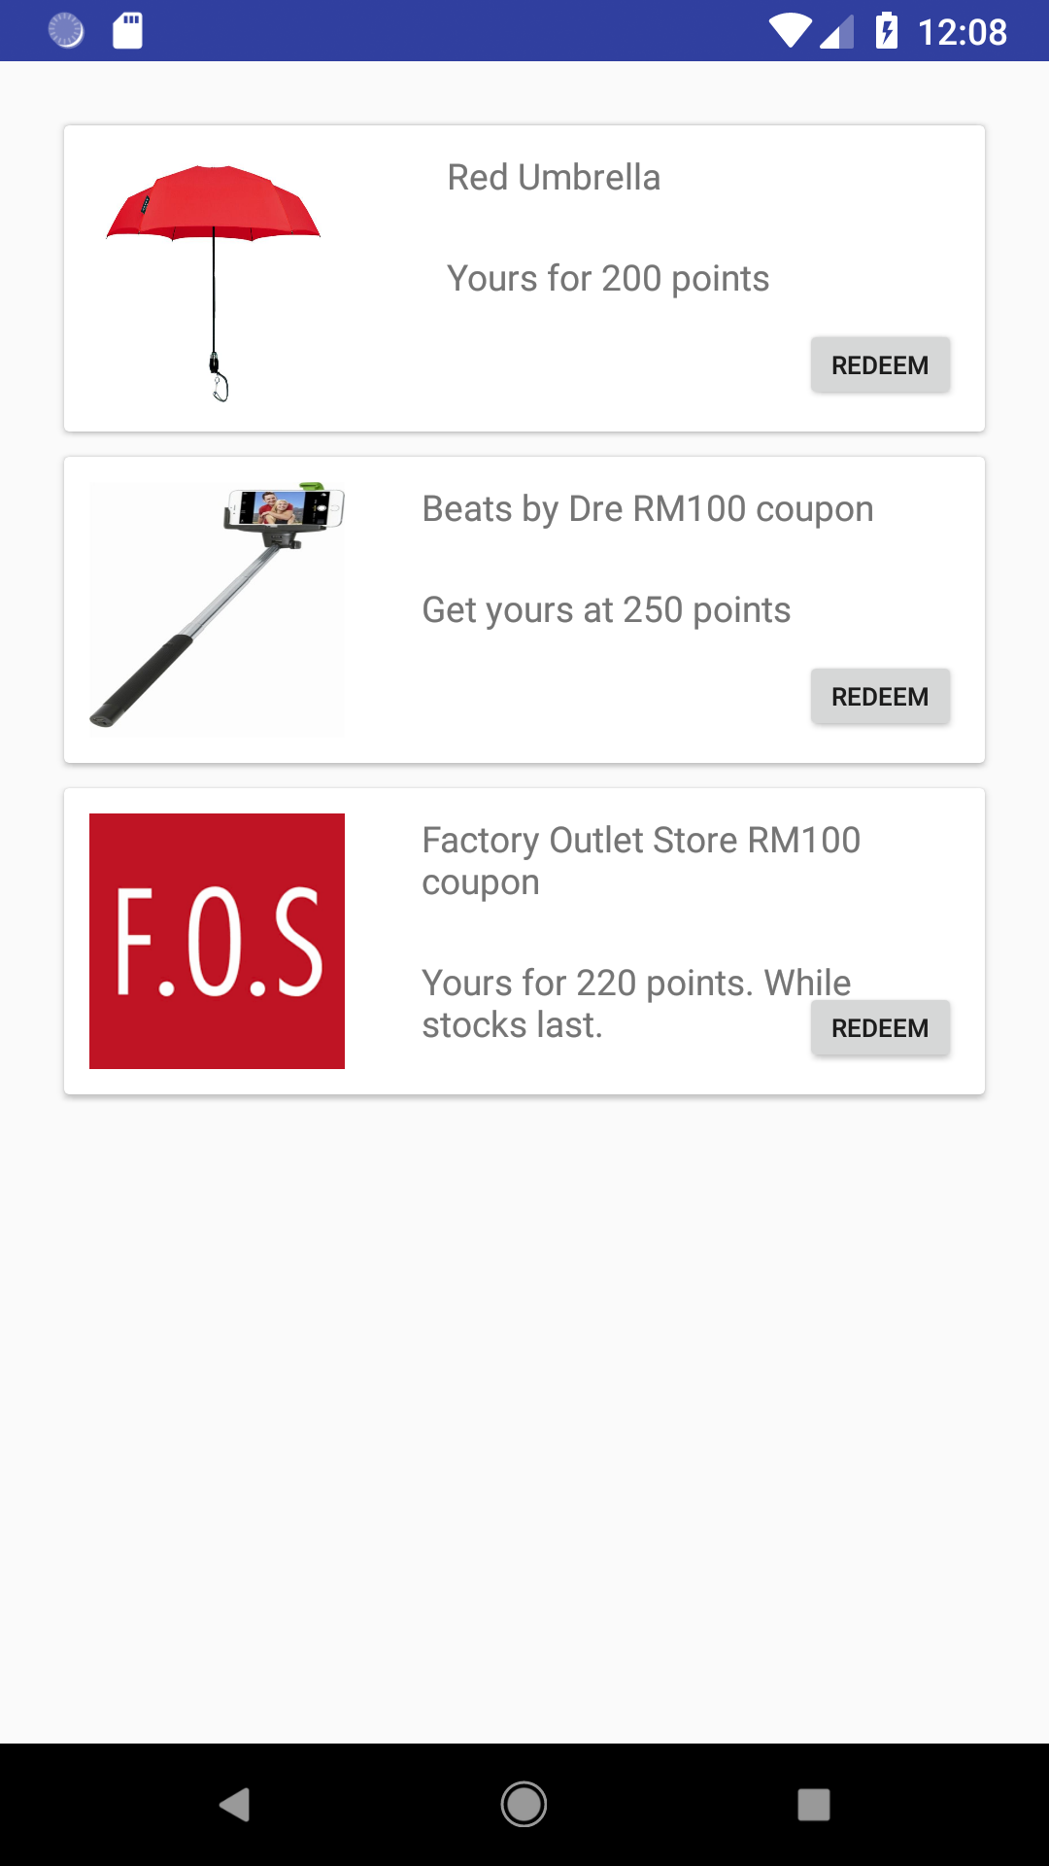
App Showcase
Point Reward System
Redemption

Slide 23
The End

Slide 24
Things to improve on
Points economy
CRUD update of promotions
Location services
General design

Slide 25
App Showcase
Rewards and Promotions

Slide 26
App Showcase
Point Reward System
Redemption

